Slide 1

Coffee Machine Simulation Project
A Python-based program for a virtual coffee vending machine
(youtube…channel(jenny maam).

Slide 2
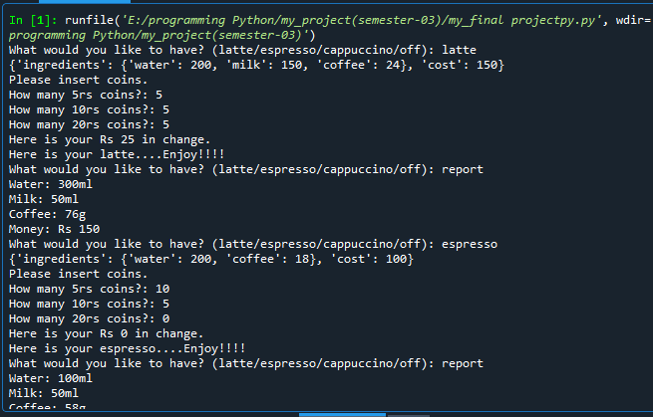
Project Overview

Slide 3
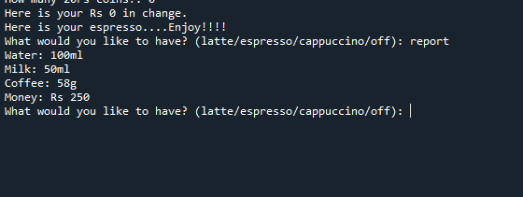
Features
Menu Options:
Latte
Espresso
Cappuccino

Slide 4
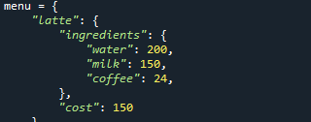
Each with specific ingredients and cost
Latte:(ingredients)
Water (200ml)
Milk (150ml)
Coffee (24g)
Cost: Rs 150

Slide 5
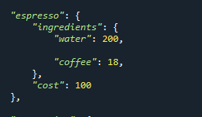
Espresso
Ingredients:
Water (200ml)
Coffee (18g)
Cost: Rs 100

Slide 6
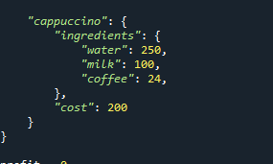
Cappuccino
Ingredients:
Water (250ml)
Milk (100ml)
Coffee (24g)
Cost: Rs 200

Slide 7
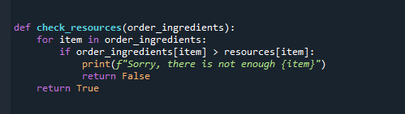
Order Fulfillment
Prepares selected coffee
Deducts used resources

Slide 8
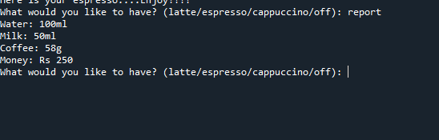
Resource Management
Tracks water, milk, and coffee grounds
Ensures sufficient resources for each order

Slide 9
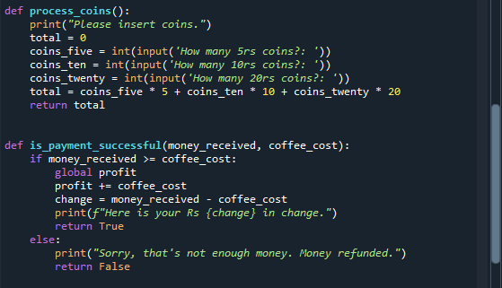
Payment Processing:
User inserts coins
Calculates total payment and checks sufficiency
Provides change and updates profits

Slide 10
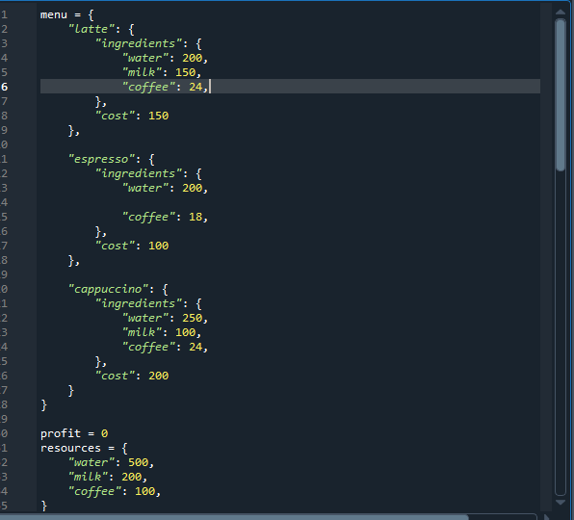
Conclusion

Slide 11
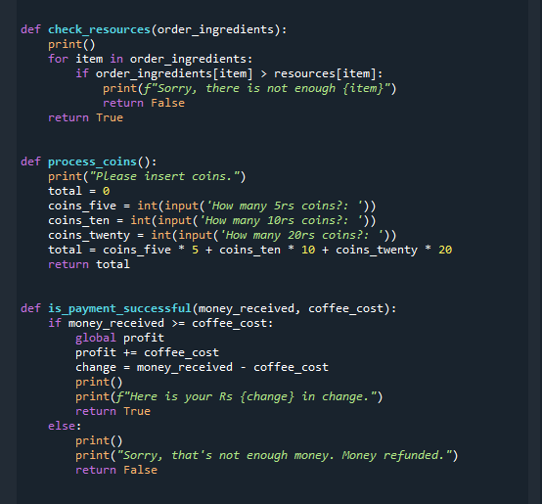
Conclusion ….

Slide 12
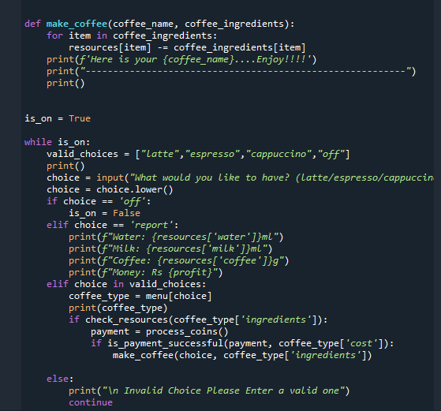
Conclusion .

Slide 13
Result
Run code in any ide

Slide 14
Question & answer section
Any question….

